Slide 1
Action Research
Dirk Riehle, FAU Erlangen
NYT C04
Licensed under CC BY 4.0 International

Slide 2
Course Content and Structure
Overview
What is science?
Scientific research
Qualitative data analysis
Theory building
Theory building
Systematic reviews
Qualitative surveys
Action research
Case study research
Theory validation
Theory validation
Survey research
Controlled experiments
Comprehensive
Design science
Academia
Academic writing
Academic publishing

Slide 3
Agenda
Action research
Participatory action research
Problem identification
Research design
The action-feedback loop
Quality assurance

Slide 4
1. Action Research

Slide 5
Action Research
Action research is a research methodology in which the researcher
Iterates over applying, evaluating, and revising a theory
To cause change and build out the theory
The researcher is not just a distant observer!

Slide 6
Facilitation vs. Participation
The researcher is not necessarily executing the action themselves
An outside researcher is a facilitator
An inside researcher is a participant

Slide 7
Duality of Purpose
The goal of action research is to
Improve practice
Build out a theory

Slide 8
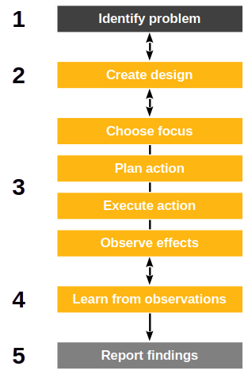
The Action Research Process
Action research is linear yet iterative
Identify research problem
Create research design
Perform action
Choose focus
Plan action
Execute action
Observe effects
Learn from observations
Report findings

Slide 9
Three Motivations for Action Research
Technical action research is interested in
Improving control over outcomes
Educational action research is motivated by
Helping practitioners act more wisely
Critical action research is motivated by
Emancipating practitioners

Slide 10
Variants of Action Research
Action research (AR) is
The original research methodology (as before)
Participatory action research (PAR) is action research in which
The researcher is an active participant of the whole research process
Critical (theory) participatory action research is action research in which
The research uses critical theory as the underlying epistemological position
Critical theory seeks
“to liberate human beings from the circumstances that enslave them” [1]
[1] See Horckheimer (1982): Critical theory.

Slide 11
As a Research Methodology Category
Action research (Lewin, 1946)
Participatory action research (McIntyre, 2008)
Critical participatory action research (Kemmis et al., 2014)

Slide 12
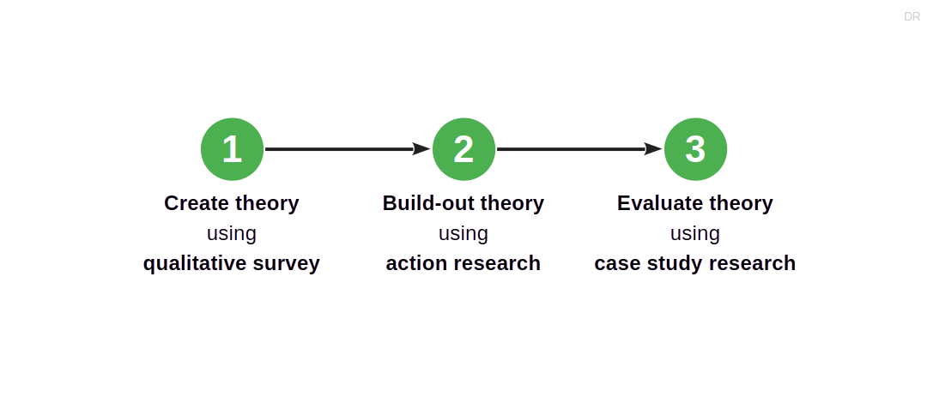
Action Research in a Larger Research Design

Slide 13
A Sweet Spot for Action Research
Participatory action research is a good choice if
There is an initial theory already in place
The researcher has access to appropriate cases
The theory under development is evolving quickly
There is significant tacit knowledge with the researcher
Participants expect to learn/benefit from the research

Slide 14
Industry Consulting as Action Research
In industry consulting (paid or unpaid), a researcher provides advice to practitioners
Researchers are called upon to help improve the outcome of practitioner work
They do not have to be participants (of implementation), but may simply advise
Industry consulting on new, novel topics, works well with action research

Slide 15
2. Participatory Action Research

Slide 16
Participatory Action Research (PAR)
Participatory action research is action research in which
Researchers and practitioners perform the work together
For the practitioners, this has the following consequences; they
Can understand and develop practices while on the case
Can develop a joint, reflective, language of critical debate
Can form communities of practice based on the research
Participatory action research is a “practice-changing practice” [1]
[1] See Kemmis et al. (2014): Critical participatory action research.

Slide 17
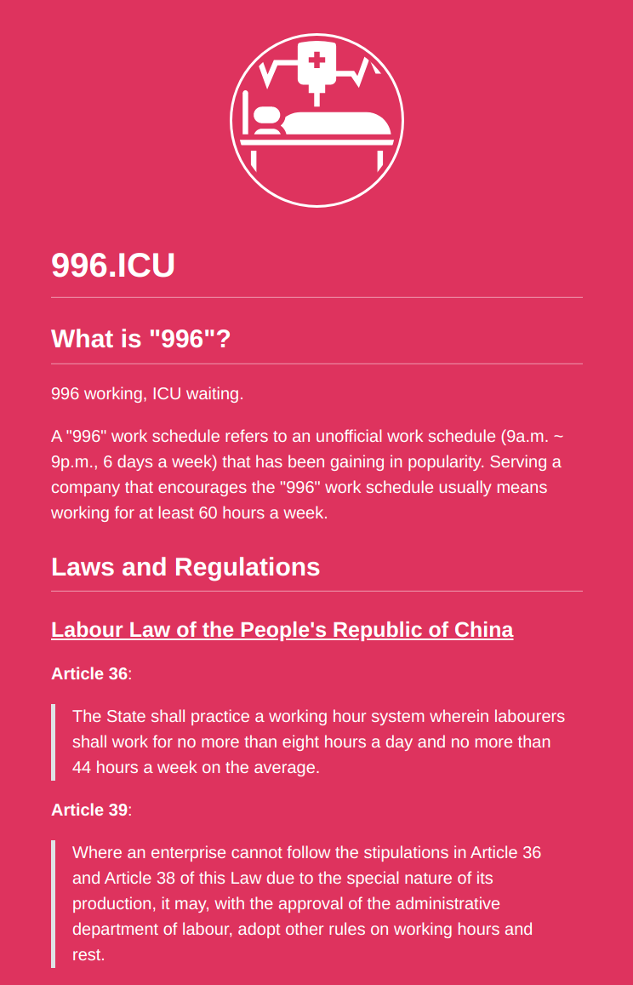
Critical Participatory Action Research (CPAR)
Critical participatory action research
Empowers participants to change practices given
irrational
unsustainable
unjust situations
With critical theory added, we are leaving positivism
No objective independent reality but rather
Individual and collective action and reflection

Slide 18
Context Specificity / No Fixed Formula
Participatory action research is context-dependent research
Every research project is different and so are the employed methods
May require significant adaptation to situation beyond the core process
Participatory action research has no single theoretical framework

Slide 19
Roles in Participatory Action Research
Everyone is a participant, some are
Researchers
Practitioners
You are either in the researcher or practitioner role
Researchers are temporary participants
Practitioners are (more) permanent participants

Slide 20
Participation vs. Involvement
Participation
Participants are stakeholders
Participation may be uneven
Involvement
No agency or ownership

Slide 21
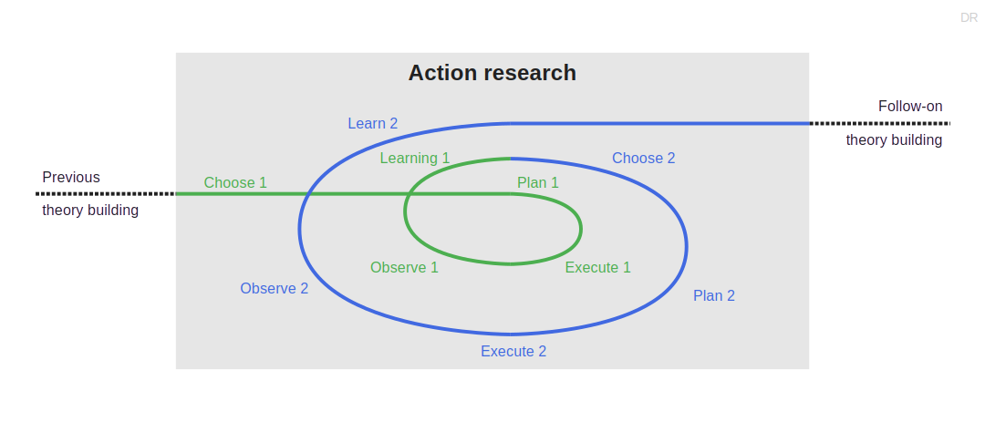
The Action Research Process in Context

Slide 22
Activity Names by Methodology Variant
Generic | Action research [1] | Participatory AR [2] | Critical PAR [3]
– | – | Questioning | –
Choosing | – | Investigating | Reconnaissance
Planning | Planning | Developing | Planning
Executing | Executing | Implementing | Enacting
Observing |  |  | Observing
Learning | Fact-finding | Refining | Reflection
[1] See Lewin (1946): Action research.
[2] See McIntyre (2008): Participatory action research.
[3] See Kemmis et al. (2014): Critical participatory action research.

Slide 23
3. Problem Identification

Slide 24
Problem Identification
You choose action research, because
Your theory is young
You may have a project at hand
The project can benefit from your help
You approach the project with the goal of
Helping practitioners
Performing research

Slide 25
Example Problem Identification
We identified a need by companies to manage using open-source software

Slide 26
4. Research Design

Slide 27
The Handbook Method
The handbook method is an approach for taking research results into practice
A research theory is codified as a best practice handbook of the domain
The best practices are derived from practitioners using a qualitative survey
Using action research, a researcher helps a practitioner apply the handbook

Slide 28
Example Theory Building
We identified a need by companies to manage using open-source software
First, we developed a theory using a qualitative survey
We then codified (wrote down) the theory as a best practices handbook
The resulting theory had substance but was still young
We then took the handbook to an industry partner for participatory action research

Slide 29
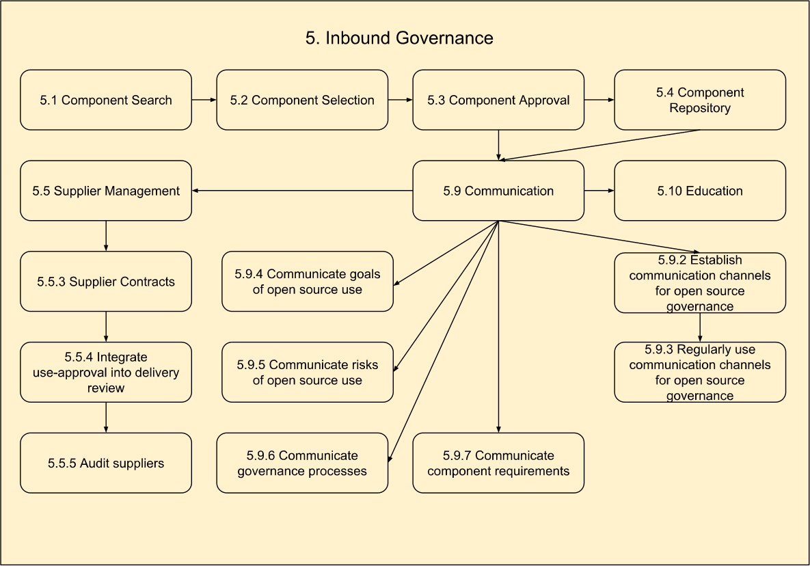
Illustration of Open Source Governance Handbook 1 / 3
Base structure
Domains
Workflows
Practices

Slide 30
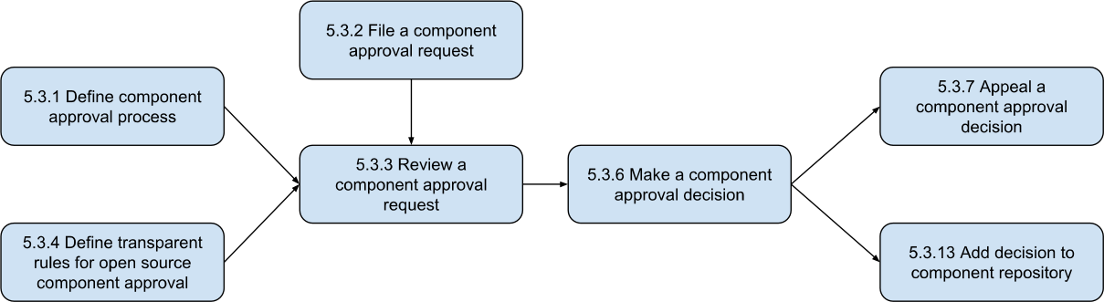
Illustration of Open Source Governance Handbook 2 / 3

Slide 31
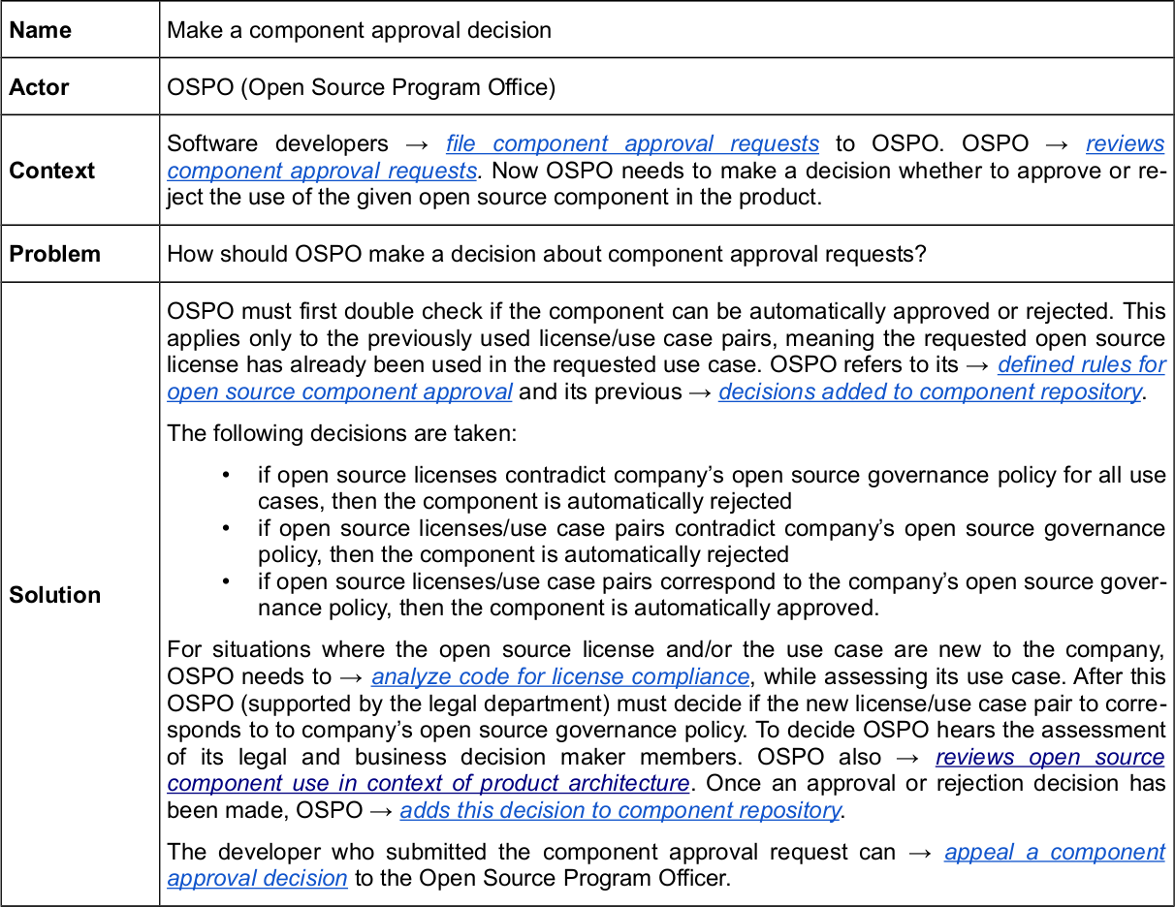
Illustration of Open Source Governance Handbook 3 / 3

Slide 32
Research Protocol
As before, describe methods and data to be acquired
As you are dealing with human subjects, also
Clearly review research ethics and implications
Document expected effects on human subjects
Devise strategies for protecting human subjects
Acquire and document ethics board approval
Include this additional information in research protocol

Slide 33
5. The Action-Feedback Loop

Slide 34
Choose Focus
During choosing (focus), you
Choose which aspect of your theory to build out
Criteria to choose focus by can be
Strategic: Immaturity of theory aspect chosen
Pragmatic: Aspect readily available in project
Action research prefers pragmatic choices
Because it is about helping practitioners

Slide 35
Example of Choosing Focus 1 / 2
We decided early to focus on the component approval process
Component approval is a critical process in open source governance

Slide 36
Example of Choosing Focus 2 / 2
As participant improving practice
We helped review the situation
As researcher performing research
We performed participant observation

Slide 37
Plan Action
During planning, you
Choose an appropriate method to perform the action and investigate its effects

Slide 38
Example of Planning an Action 1 / 2
We worked with the OSPO to define the component approval process
We used the handbook to define a first version of the process

Slide 39
Example of Planning an Action 2 / 2
As participant improving practice
We helped define the process
As researcher performing research
We continued participant observation

Slide 40
Execute Action
During execution, you follow your plan and
Participate in the project working on the aspect of choice

Slide 41
Example of Executing Action 1 / 2
We helped the first component approval processes along
We performed both entry and exit interviews
We performed participant observation

Slide 42
Example of Executing Action 2 / 2
As participant improving practice
We helped the first process instances
As researcher performing research
We continued participant observation
We performed entry interviews
We performed exit interviews

Slide 43
Observe Effects
During observation, you continue with your plan and
Observe the results of the execution using the methods you chose

Slide 44
Example of Observing Effects 1 / 2
After the action, in addition to in-action observations, we reviewed the results
More interviews with the OSPO after a couple of instances had run
Taking note of statistics (duration, complications, results)

Slide 45
Example of Observing Effects 2 / 2
As participant improving practice
We were not involved
As researcher performing research
Continued participant observation
Conducted additional interviews
Took notes of emerging statistics

Slide 46
Learn from Observations
During learning, you
Analyse the observed data towards the aspect of interest

Slide 47
Example of Learning from Observations 1 / 2
We built out our theory and used it to provide feedback and make suggestions

Slide 48
Example of Learning from Observations 2 / 2
As participant improving practice
Discussed ways to improve process
As researcher performing research
Integrated collected data into theory

Slide 49
Closing the Action-Feedback Loop
Based on what you learned, you
Either continue with another iteration of action research
Or move on to next steps (publications / methodology)

Slide 50
6. Quality Assurance

Slide 51
Quality Assurance
Quality assurance is closely tied to the research methods employed
In our example (open source governance) these were
Participant observation
Practitioner interviews
Qualitative data analysis

Slide 52
Summary
Action research
Participatory action research
Problem identification
Research design
The action-feedback loop
Quality assurance

Slide 53
Thank you! Any questions?
dirk.riehle@fau.de – https://oss.cs.fau.de
dirk@riehle.org – https://dirkriehle.com – @dirkriehle

Slide 54
Legal Notices
License
Licensed under the CC BY 4.0 International license
Copyright
© 2012-2026 Dirk Riehle, some rights reserved

